Slide 1


SenCom: Integrated Sensing and Communication with Practical WiFi
Yinghui He⁺, Jianwei Liu⁺, Mo Li*, Guanding Yu⁺, Jinsong Han⁺, Kui Ren⁺
⁺Zhejiang University
*The Hong Kong University of Science and Technology
2023-10-05

Slide 2

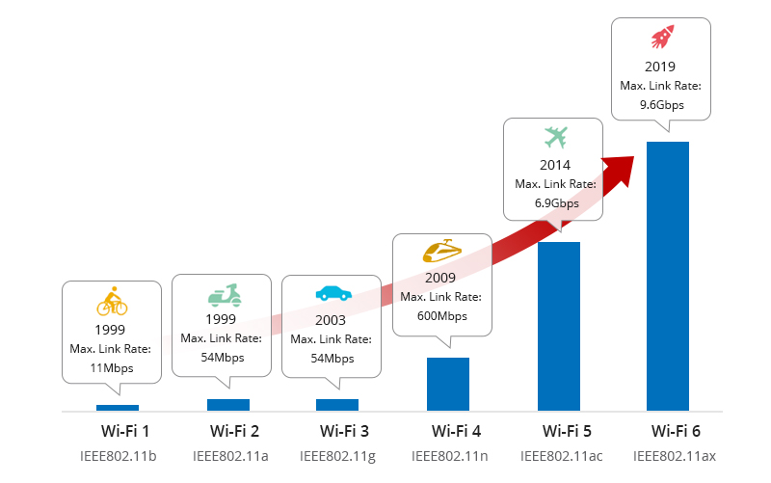
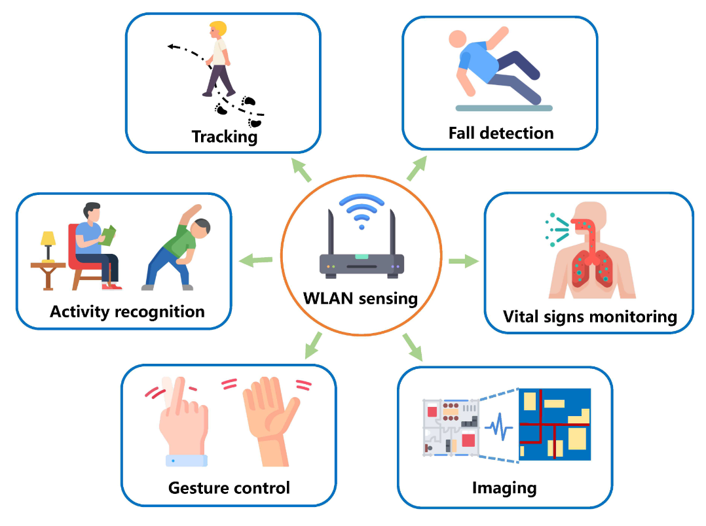
Integrated Sensing and Communication (ISAC)
Communication
Sensing
They use the same hardware and frequency spectrum.
Integrated Sensing and Communication (ISAC)
Sensing and communication functions co-exist with the same hardware and spectrum to utilize resources efficiently.
High-speed data rate and low latency
Support device-free target sensing

Slide 3

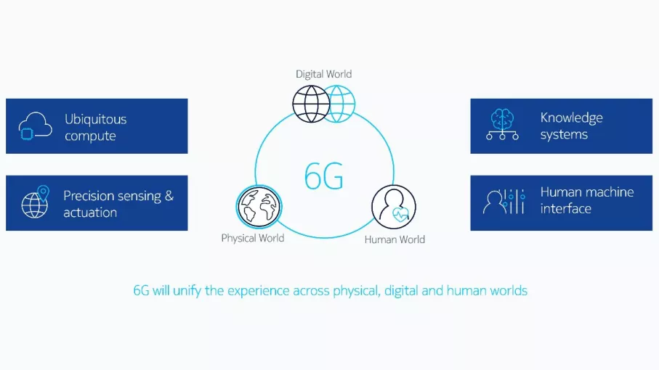







Flaws of Existing Approaches
Design brand-new standard, hardware, network architecture, etc. for ISAC
IEEE 802.11 bf
New standard
New hardware
New network architecture
Long time & high cost
4 years
2019 $→$ 2023
$$≫$$
Cost of 5G BS that of 4G BS
# of 5G BS: 2.3 million Proportion of 5G BS:
2.5$×$
21.3%
Long time!
High cost!

Slide 4




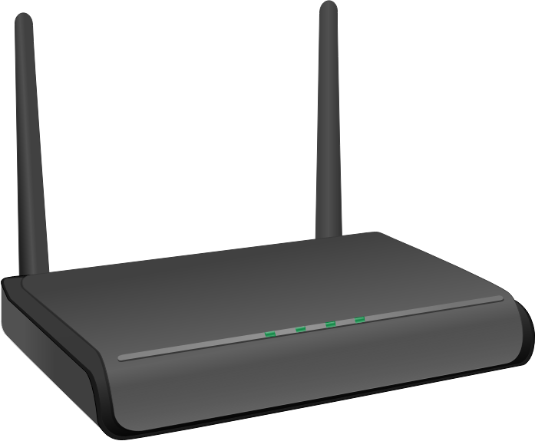
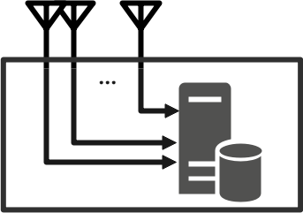
Our Solution: SenCom
ISAC with existing standard/devices;
High sensing and communication performance;
ISAC with existing standard/devices;
High sensing and communication performance;
Packets
WiFi AP
CSI
Walk
SenCom

Slide 5








Challenge 1 – Low Quality of CSI
WiFi AP
Client with SenCom
Physical-world CSI
TS
Data
Beamfo-rming
Spatial Mapping
OFDM
OFDM
Channel estimation
SenCom
CSI
$$X$$
. . . . . .
. . . . . .
. . . . . .
. . .
$$Y$$
TS
Data
OFDM
OFDM
$$V$$
$$Q$$
$$H$$
Equalization
Data
$$Y = H Q V X$$
$$Y = H V X$$
$$Y = H X$$
𝑴𝒆𝒂𝒖𝒔𝒓𝒆𝒅 𝑪𝑺𝑰: $G =H Q V$

Slide 6


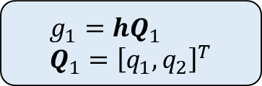


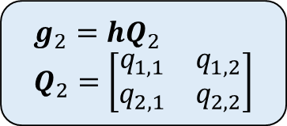
Low Quality Caused by $Q$
𝑴𝒆𝒂𝒖𝒔𝒓𝒆𝒅 𝑪𝑺𝑰: $G=H Q V$
Different Communication Modes $→$ Different $Q$ $→$ Different CSI
WiFi AP
SenCom
Diversity mode
$$g_{1}=hQ_{1} \\ Q_{1}={\left[q_{1},q_{2}\right]}^{T}$$
$$Q_{1}$$
Different Dimensionality
Multiplexing mode
$$g_{2}=hQ_{2} \\ Q_{2}=\left[\begin{matrix}q_{1,1} & q_{1,2} \\ q_{2,1} & q_{2,2}\end{matrix}\right]$$
$$Q_{2}$$

Slide 7
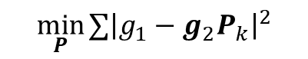


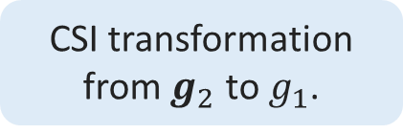
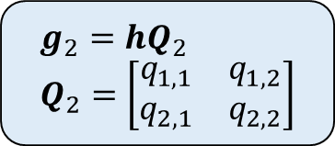
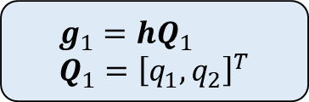
CSI Transformation
𝑴𝒆𝒂𝒖𝒔𝒓𝒆𝒅 𝑪𝑺𝑰: $G=H Q V$
Solution: Unify CSI across Different Modes
Diversity mode
$$g_{1}=hQ_{1} \\ Q_{1}={\left[q_{1},q_{2}\right]}^{T}$$
$$g_{1}=g_{2}P$$
A scalar
CSI transformation
from $g_{2}$ to $g_{1}$.
$$P=Q_{2}^{−1}Q_{1}$$
Multiplexing mode
$$g_{2}=hQ_{2} \\ Q_{2}=\left[\begin{matrix}q_{1,1} & q_{1,2} \\ q_{2,1} & q_{2,2}\end{matrix}\right]$$
$$\min_{P}{∑{\left|g_{1}−g_{2}P_{k}\right|}^{2}}$$
A vector

Slide 8




Low Quality Caused by $V$
𝑴𝒆𝒂𝒖𝒔𝒓𝒆𝒅 𝑪𝑺𝑰: $G=H Q V$
Beamforming $V$ $→$ Weak Signal & CSI
2) Feedback
1) NDP
3) Data
Weak 𝑪𝑺𝑰
$$G=H Q V$$
WiFi AP
SenCom

Slide 9


CSI Compensation
𝑴𝒆𝒂𝒖𝒔𝒓𝒆𝒅 𝑪𝑺𝑰: $G=H Q V$
Solution: Reconstruct $V$ with Sniffing
2) Feedback
Sniff to feedback
1) NDP
Reconstruct $V$
WiFi AP
Compensation
$$G V^{−1}=H Q$$
SenCom

Slide 10
Challenge 2 – Insufficient CSI
Unstable Communication Traffic $→$ Insufficient
SenCom
No CSI
Time

Slide 11

Challenge 2 – Insufficient CSI
Solution: Incentive Strategy
Incentive
SenCom
Optimal Incentive Rate: $λ^{i}={\left[\frac{1}{𝔼\left\{W\right\}}\left(1−\sqrt{\frac{1−β}{β}}𝔼\left\{W^{2}\right\}\right)−λ^{c} \right]}_{0}^{\frac{1−ε}{𝔼\left\{W\right\}−λ^{c}}}$
Time

Slide 12
Challenge 2 – Insufficient CSI
Unstable Communication Traffic → Uneven
SenCom
Uneven
Time

Slide 13
Challenge 2 – Insufficient CSI
Solution: Fitting and Resampling
SenCom
Time

Slide 14
Challenge 2 – Insufficient CSI
Solution: Fitting and Resampling
SenCom
Time

Slide 15
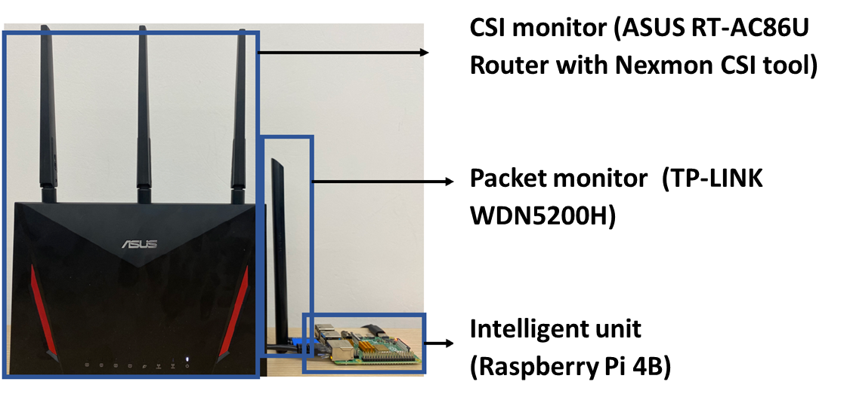

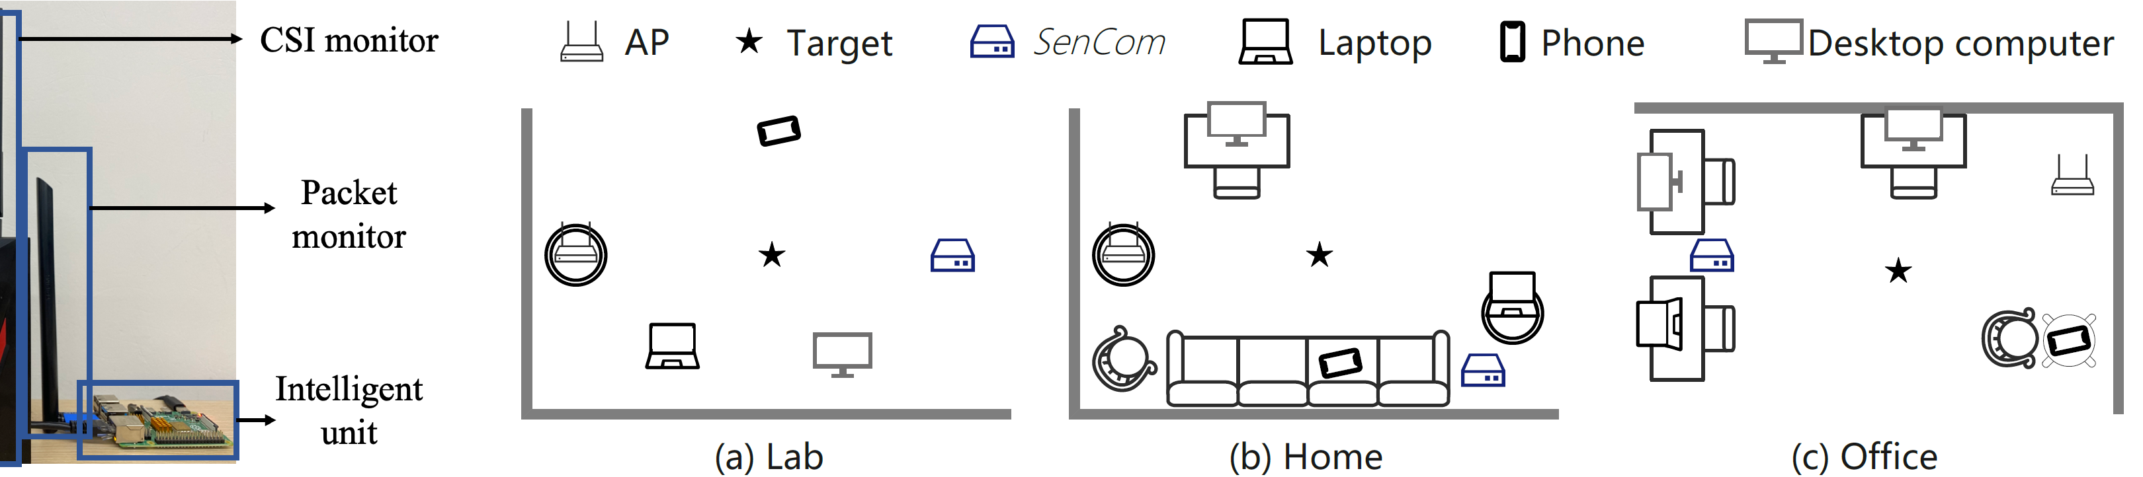
Prototype and Settings
Commercial Off-The-Shelf (COTS) Hardware
80
10
60
Evaluation Settings
Lab
Home
Office

Slide 16




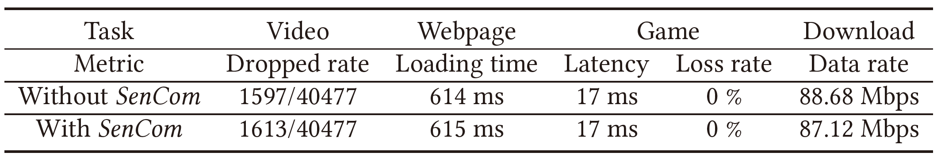
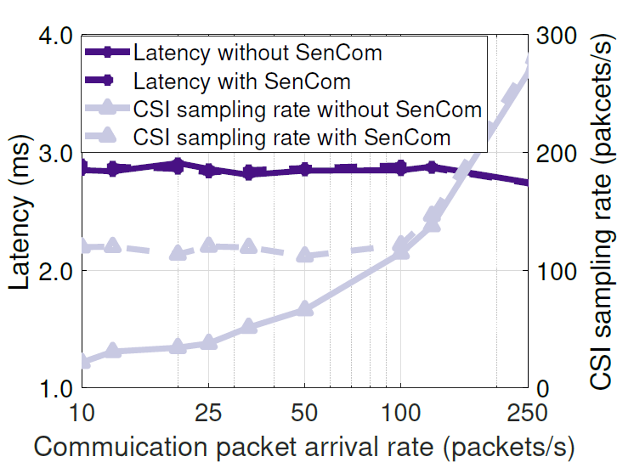

Negligible Communication Loss
Quality of Experience (QoE)
Latency & Throughput
Communication Loss $≤$ 2%

Slide 17
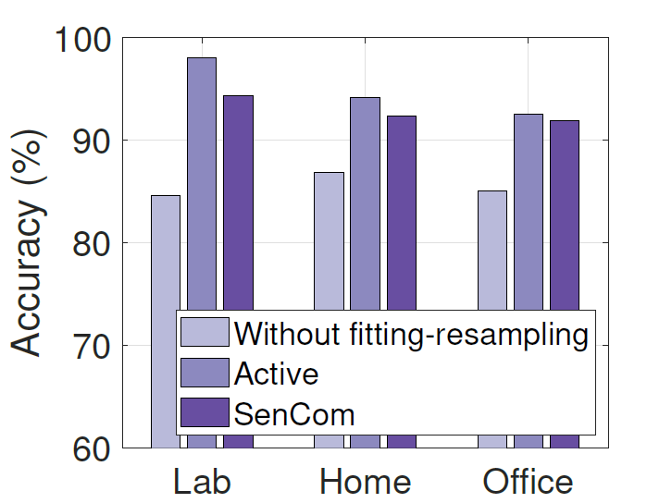
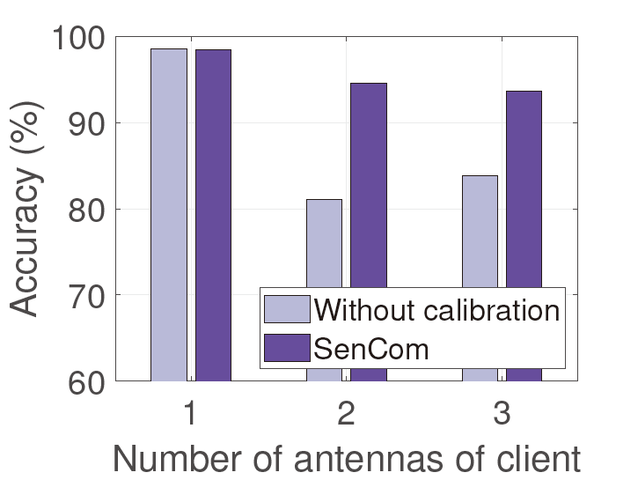
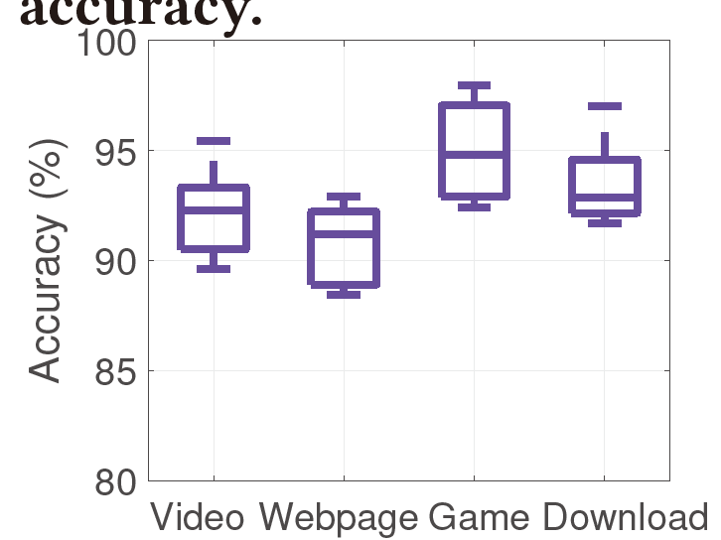

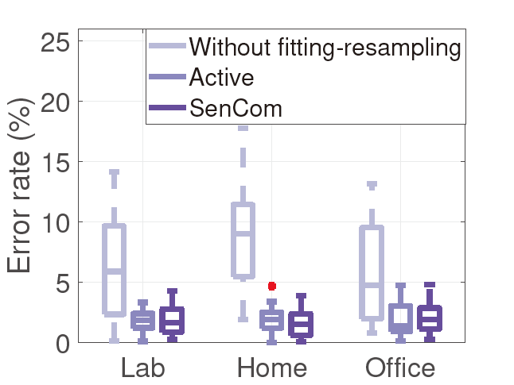
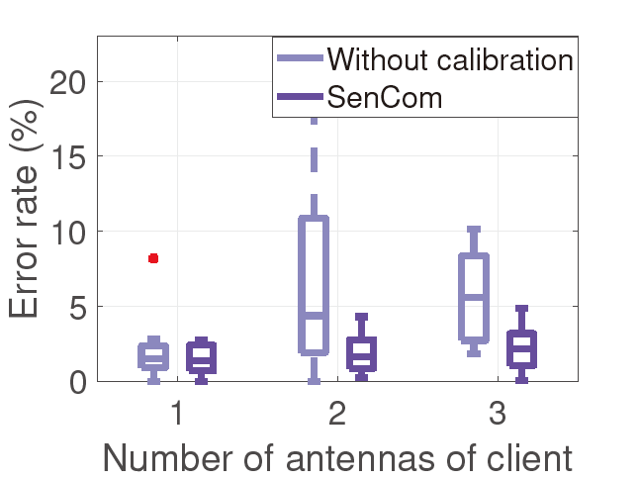
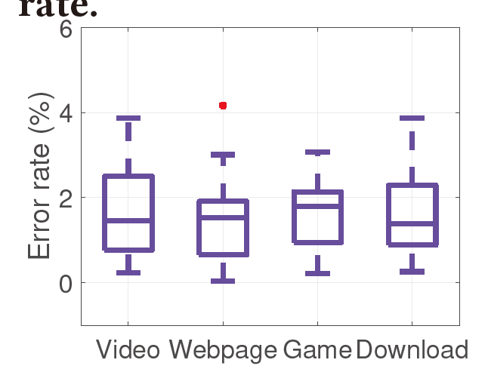

Remarkable Sensing Performance
WiFall: a fall detection system
WiStep: a step counting system

Slide 18
Conclusion
Target
Systems
Solutions
Results
Challenges
CSI Transformation
Low Quality
Negligible Communication Loss
Remarkable Sensing Performance
CSI Compensation
ISAC
SenCom
Incentive Strategy
Insufficiency
Fitting Resampling

Slide 19


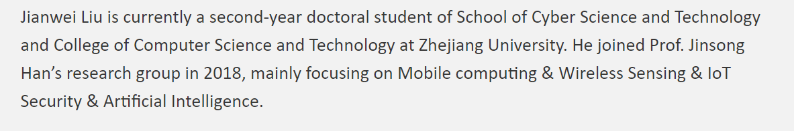
Thank you!
Contact Us
Yinghui He (2014hyh@zju.edu.cn) Personal Page: https://hyh6540.github.io/
Jianwei Liu (jianweiliu@zju.edu.cn) Personal Page: https://dragonflycaptainl.github.io/

